Slide 1
Community of Practice
Jim Knauf,
UIUC Project Manger
Robyn Lewis, PhD.
IDHS-DRS Project Manager
April 3, 2024

Slide 2
Agenda
COP Critical Function | SWTCIE Illinois Agenda Item
Educate | Customer Profile
Support | Q & A on educational topic
Encourage | Customer and Agency highlights
Cultivate | Open Discussion
Integrate | Homework—Apply something you learned today in your daily practice

Slide 3
March Highlights
Executive Staff Summit
CRS’s engaged in benefits planning training
New ACRE course date set
Outreach events
Leadership trainings
VCU site visits
Activity Log Launch
Release of Information and Customer Participation Form

Slide 4
SWTCIE Illinois By the Numbers
YOU ARE DOING GREAT!!
Agency | Total Engaged Participants | DRS Customers | Competitive Job Placements
AID | 9 | 9 | 0
Centerstone | 6 | 4 | 1
CTF | 8 | 8 | 2
HSS | 7 | 4 | 0
Kreider Services | 8 | 4 | 1
The Workshop | 8 | 8 | 5
TOTAL | 48 | 37 | 9
Notes:
At the end of 5 months in the pilot year, 4 of the 6 agencies have met or exceeded the goal of 8 project participants. 77% of those engaged are DRS customers. 24% of DRS customers have a competitive job! Excellent work!

Slide 5
Change
Systems don’t change just because we identify them;
they change because we disrupt them.
- Cornelius Minor
Minor, Cornelius. (2019). We got this. Equity, access, and the quest to be who our students need us to be. Portsmouth, NH: Heinemann.

Slide 6
Developing a Job Seeker Profile and Effective Use of Situational Assessments
Vicki Brooke, M.Ed.
Consultant

Slide 7
Phases of Supported Employment
Job Seeker Profile
Person Centered and Assessment Driven
Job Development
Informed by Job Seeker Profile
Job Site Training & Support
Individualized, Behavior Supports, Identification of Natural Supports
Follow Along
Changes in Task, Management or Natural Supports
Not Time Limited

Slide 8
What Happens In Each Phase?
Job Development
Supported by a job coach
Finding CIE in the community.
Meet the needs of the business & the strengths of the job seeker
Job Site Training
Supported by a job coach
Learning job skills, workplace culture, appropriate behavior, identifying new tasks that can be learned
Job coach provides intensive support at outset, decreases time as independence is reached
Follow Along Support
The Job Coach never really leaves
Employee is stable on their job, but job coach continues to check in with employee and employer to ensure satisfaction, provide support as needed, identify areas of growth, assist in meetings and evaluations
(V. Brooke, 2024)

Slide 9
Phase 1: Building a Job Seeker Profile
Critical first step
Learn about individual’s interests, skills and abilities
Variety of Interviews
Job Seeker
Family
Other Supports
Observations
Community Assessments
Situational Assessments
(V. Brooke, 2024)

Slide 10
Using a Person Centered Approach
What is the Dream
What is the nightmare
Who is the person
What is the person good at
What does the person need
What is the plan of action
What is the map
What is the person story -- history
(V. Brooke, 2024)

Slide 11
Job Seeker Intake
May be first time meeting the job seeker
Should be conversation driven
Multiple inputs from the individual, family, friends and other supports
Questions about work and recreational interests
Search for gifts, talents and strengths
See people in the context of the community
Identify their contributions
(V. Brooke, 2024)

Slide 12
Job Seeker Intake Questions
Who would you like to be present during the intake?
What are questions you think need to be asked during the intake process?
What motivates you?
**Intake Form
(V. Brooke, 2024)

Slide 13
Informed Choice
What is informed choice?
How can we ensure that PWD are able to make informed decisions?
(V. Brooke, 2024)

Slide 14
Thoughts on Informed Choice
What people don’t want is as important as what they do want
Choice making must include familiarity with choice options/activities
Sometimes what people want is not possible
(V. Brooke, 2024)

Slide 15
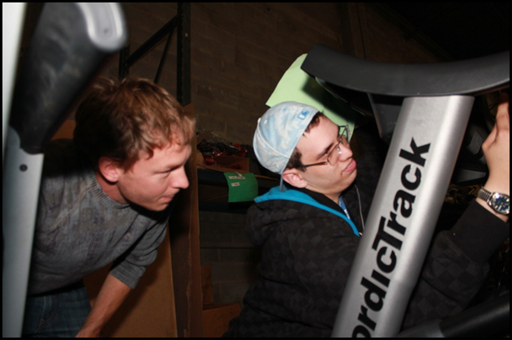
Areas of Assessment
Learning and Learning Styles
Productivity
Job Seeker Interest
Communication Style
Social Interaction
Worker Traits
Initiative/Motivation
Physical Ability/ Appearance
(V. Brooke, 2024)

Slide 16
Traditional Attitude Towards Employment and PWD
They cannot fulfill requirements of existing jobs
Assessments focus on what people cannot do
Real work cannot be simulated
Environmental factors may be controlled
Materials/tools may not match the needs of the workplace
Supports needs indicated that they were not ‘ready’ for employment
(V. Brooke, 2024)

Slide 17
Language of Assessment
We…. | They…
Like things | Fixate
Make friends | Have attention seeking behavior
Take a break | Go off task
Focus | Perseverate
Insist | Tantrum
Have talents | Have splinter skills
Stand up for ourselves | Are noncompliant
(V. Brooke, 2024)

Slide 18
Deficiency Viewpoint → Capacity Viewpoint
Purpose of Supported Employment assessments is to make the best match between a potential employee’s strength, support needs and preferences; and the strengths, needs and dynamics of a potential employment site.
(V. Brooke, 2024)

Slide 19
Situational Assessments
Group experience using a similar Situational Assessment Form?
Useful / Not Useful?
Why multiple assessment sites?
(V. Brooke, 2024)

Slide 20
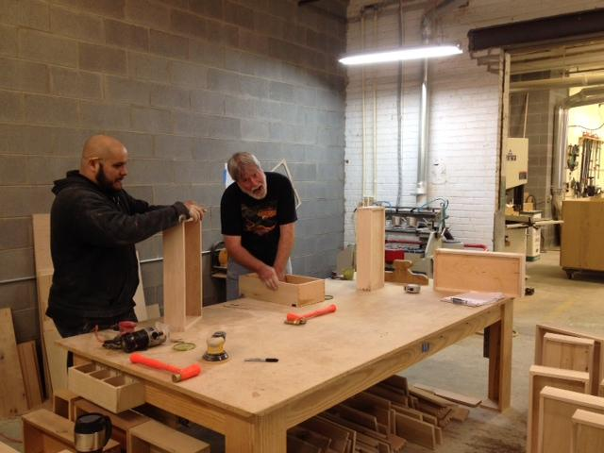
Setting Up a Situational Assessment
Can be three hours, a day or week long assessments
Real work setting*
Assessment should reflect job seeker goal
Part time or Full time
Work environment
Job Tasks
(V. Brooke, 2024)

Slide 21
Developing a Situational Assessment
Contact business
Identify and analyze appropriate tasks
Schedule situational assessment
Record Assessment observations
(V. Brooke, 2024)

Slide 22
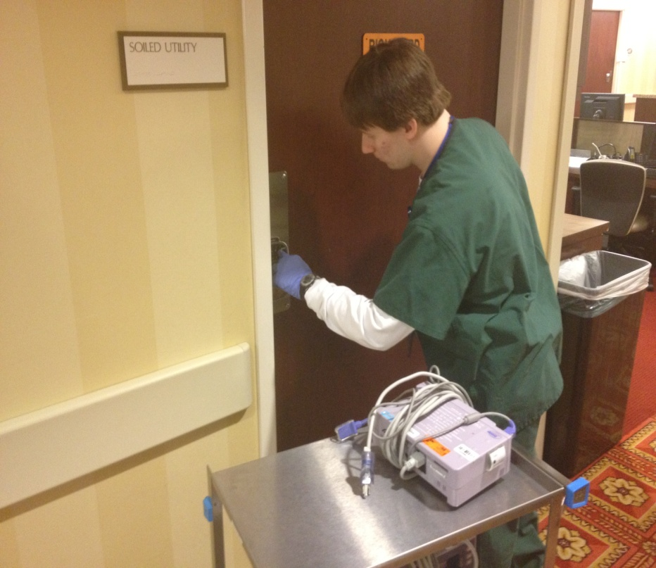
Situational Assessment Example: “James”
Observed assessment in the Respiratory Therapy department of a healthcare system
Tasks:
Collected soiled pulse oximeters from biohazard rooms and cleaned, sanitized, and cleared patient trends on the machines.
(V. Brooke, 2024)

Slide 23
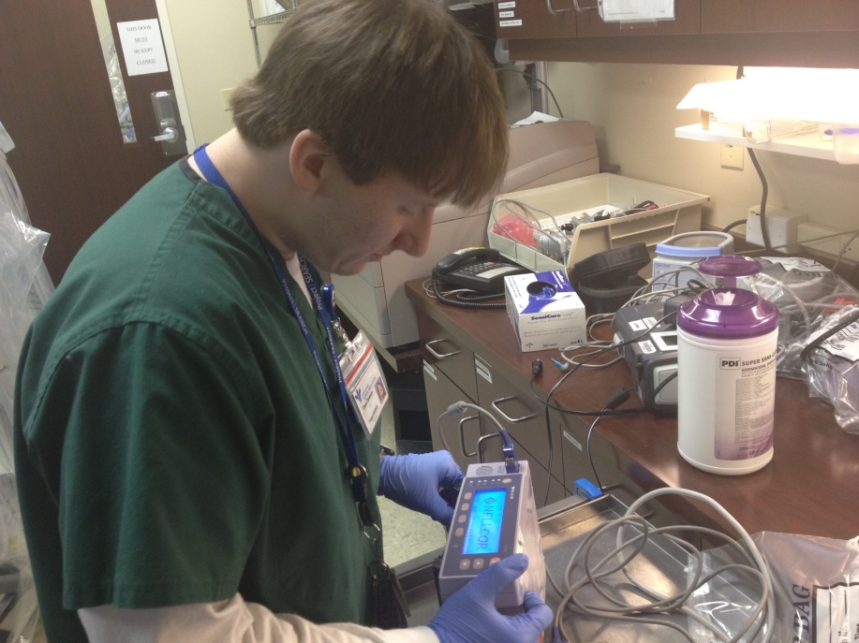
What Did We Learn?
Observed Strengths:
Follows written instruction, excels in routine, repetitive tasks, “perfectionist”
Observed Barriers:
Requires rigid schedule, exhibits oppositional self-stimulating behaviors
(V. Brooke, 2024)

Slide 24
Situational Assessment Example: “Kevin”
Participated in extended assessment in the Materials Management department of a hospital setting
Tasks: Counted, inventoried, and ordered patient supply items for various floors
(V. Brooke, 2024)

Slide 25
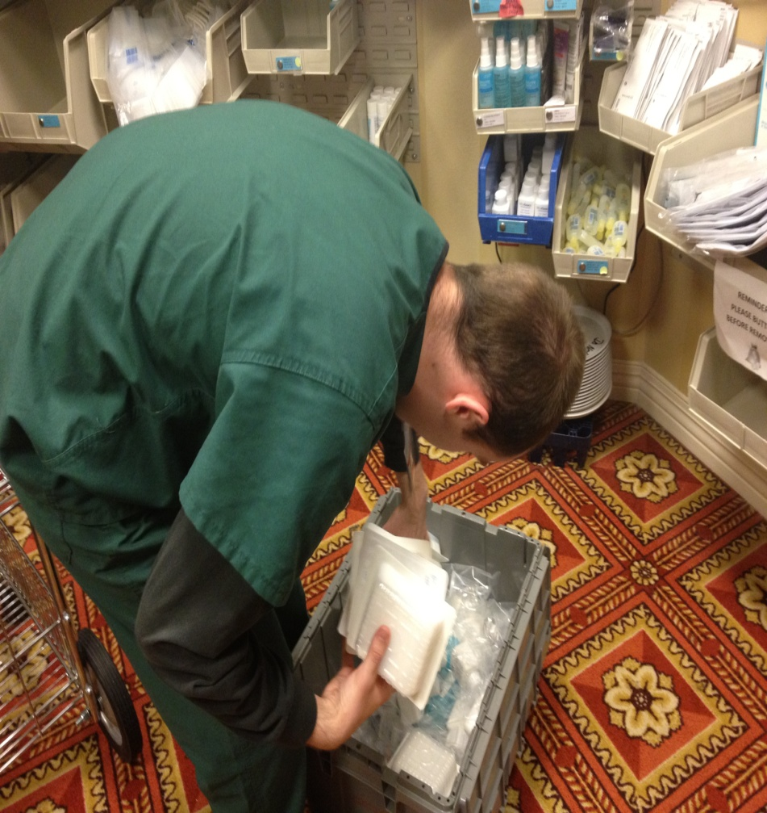
What Did We Learn?
Observed Strengths:
Extremely thorough, strong in areas of task acquisition and completion, follows directions, always eager to please
Observed Barriers:
Works at below average work pace, impatient with time constraints, requires prompting to initiate new tasks
(V. Brooke, 2024)

Slide 26
Probing Compensatory Strategies
Using a checklist
Create and teach compensatory strategy
Use of technology
(V. Brooke, 2024)

Slide 27
Collecting Data: Assessment Report
Description of assessment location
Description of job tasks
Learning and preferred learning style
Production rate
Task acquisition
Motivation/ Initiative
Interpersonal
Initiate conversation
Soft skills
Job Seeker Presentation
Recommendations
(V. Brooke, 2024)

Slide 28
Educational Topic Q & A
What are your questions related to the topic presented?

Slide 29
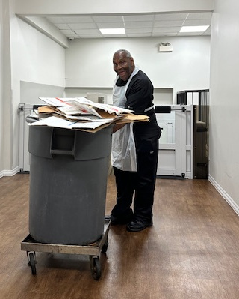
Customer Case Study
Chester
Subminimum Wage Earner
Adult
Royal Estates Assistive Living (LeeGacy LLC)
14.00 Hourly
Ave. 16 Hours A Week

Slide 30
Chester’s Team
DRS counselor: Richard Jones/Sheila O’Donnell
UIUC community research specialist: Kyle Menke
Agency employment specialist: Quintina Terry
Personal support worker: Elyse (Sertomastar)
Wrap around or other special services: Tom Costello, individual services coordinator, Suburban Access Inc.
Key family supporters: Otis (cousin)
On the job supporters: Mr. Lee, hiring manager (CHEF)/Ms. Flo, team lead

Slide 31
Chester’s DRS process
What Contract type: Customized Employment
Date of Referral: 10/26/23
Date of Eligibility: 11/17/23
Date of IPE initiation: 11/17/23
What information was sent with the referral: Resume, Personal Plan, Social Security Card, Medical card, State ID Psychological, Consent to Service.
What additional information was required to determine eligibility: Face to face interview with DRS counselor

Slide 32
Chester’s Employer
Royal Estates Assistive Living (Lee Gacy LLC)
Dishwasher/Stocker/Dietary Aide
Are you customizing employment or are you providing accommodations to a job position available to the general public? Yes, the position was customized by time to accommodate limited transportation hours, job responsibilities split and paired with another worker
How did you gain entry/build employer relationship? Identified area support living, called to try to set meeting, instructed to complete application, during interview process, discussed job needs, and customized job duties

Slide 33
Chester’s Employment Barriers
Employment Barrier | Mitigation Strategies
Employees Age | The hiring manager simply liked Chester and saw the benefits he would bring to the facility
New transportation schedule | Quintina created laminated reminder cards showing name, PACE pick up times, address of jobsite
Close to home | 25-minute ride to and from jobsite
Original hours were 6:00 AM – 10:00 AM | Quintina explained that Chester uses PACE for Transportation and PACE is not always the most reliable. Hiring manager agreed to change Chester’s hours to 10:00 Am – 2:00 PM
Chester had some difficulty following time sheet | Color code work schedule/time sheet
Using App to keep track of his work schedule | Quintina creating picture supports to help Chester log in to correct App (Paychex), find work schedule
*Include barriers with the employer, the state system, and/or family*

Slide 34
Lessons Learned
What did you learn with this customer’s employment process? The different steps of the employment process, ensuring travel funds, correct uniform, learned daily duties for kitchen area dinning, trash disposal. Completed a food handler certification to learn specific temperatures of water, and food storage arrangements
What will you do differently with the next customer? During Discovery look into time management skills depth.
What are your strategies to ensure the customer and employer remain satisfied for this employment situation? Continue providing job coaching, create new task analysis for additional responsibilities, verbal praise. Weekly communication with employer.

Slide 35
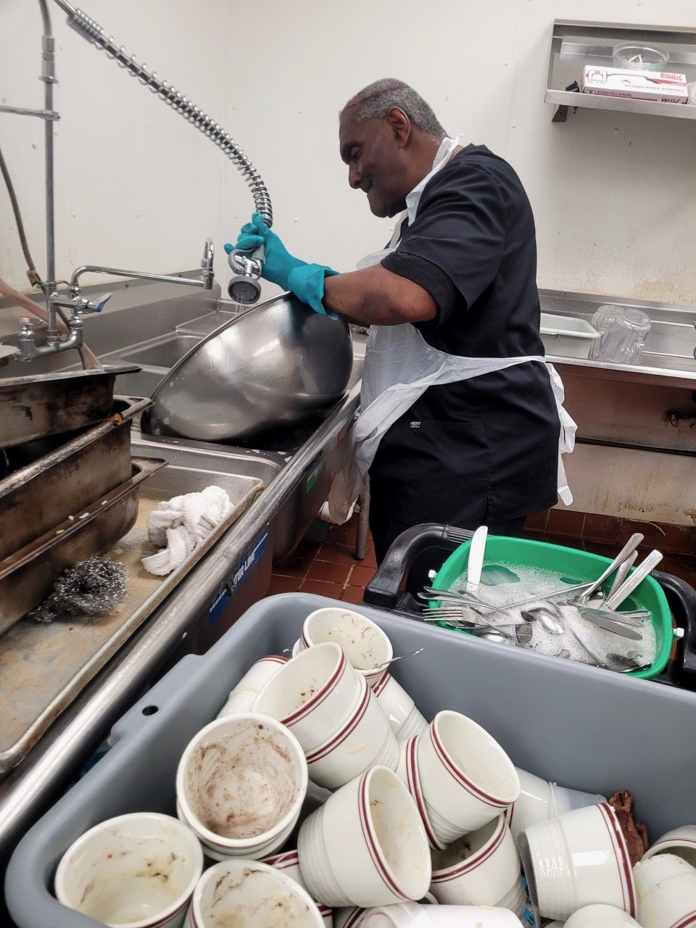
Message from Chester
What do you like best about your job (and why)? “I like to stay busy and meet new people.”
How does working at Royal Estates and being a SWTCIE participant make you feel? “Makes me happy and feel useful.”
What do you plan to/did you do with your first paycheck? “Open a savings account, pay phone bill, get haircuts, pay for my transportation.”

Slide 36
SWTCIE Illinois
What are the questions from the SWTCIE Illinois COP community?

Slide 37
Agency Highlights
What have you done to disrupt the system?
What is your biggest accomplishment?
What do you plan to apply from today to your practice?

Slide 38
Open Discussion
Release of Information and Customer Participation forms
Questions
Concerns
Advise/Support
General Comments

Slide 39
End

Slide 40
Why a Community of Practice?
According to Wenger (1998), communities of practice provide five critical functions. They:
Educate by collecting and sharing information related to questions and issues of practice
Support by organizing interactions and collaboration among members
Cultivate by assisting groups to start and sustain their learning
Encourage by promoting the work of members through discussion and sharing
Integrate by encouraging members to use their new knowledge for real change in their own work.

