Slide 1
Community of Practice
Jim Knauf,
UIUC Project Manger
Robyn Lewis, PhD.
IDHS-DRS Project Manager
March 6, 2024

Slide 2
Today’s Agenda
Introduction
Presentation | SWTCIE Illinois Customer Selection Paul Wehman, Ph.D., and Jennifer McDonough, Virginia consultants
Presentation Q&A
Customer Case Study | Charley The Workshop
Open Discussion
Next Steps/Adjourn

Slide 3
SWTCIE Illinois Customer Selection
Paul Wehman, Ph.D. and Jennifer McDonough Virginia consultants

Slide 4
Educational Topic Q & A
What are your questions related to the topic presented?

Slide 5
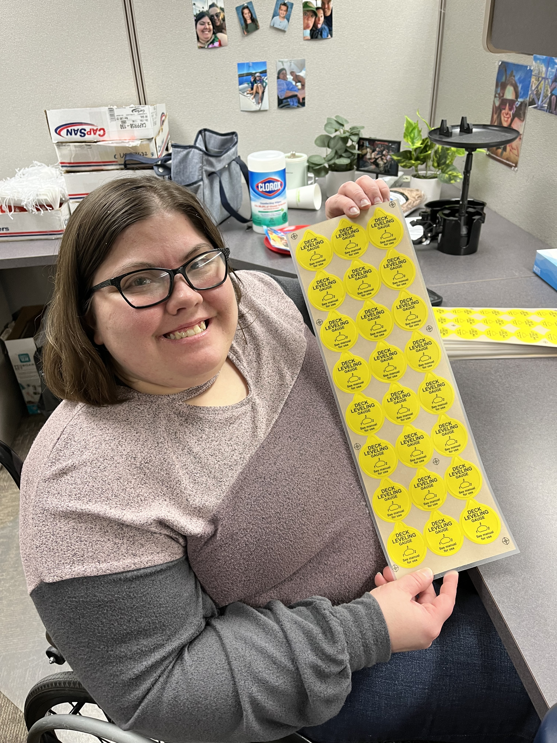
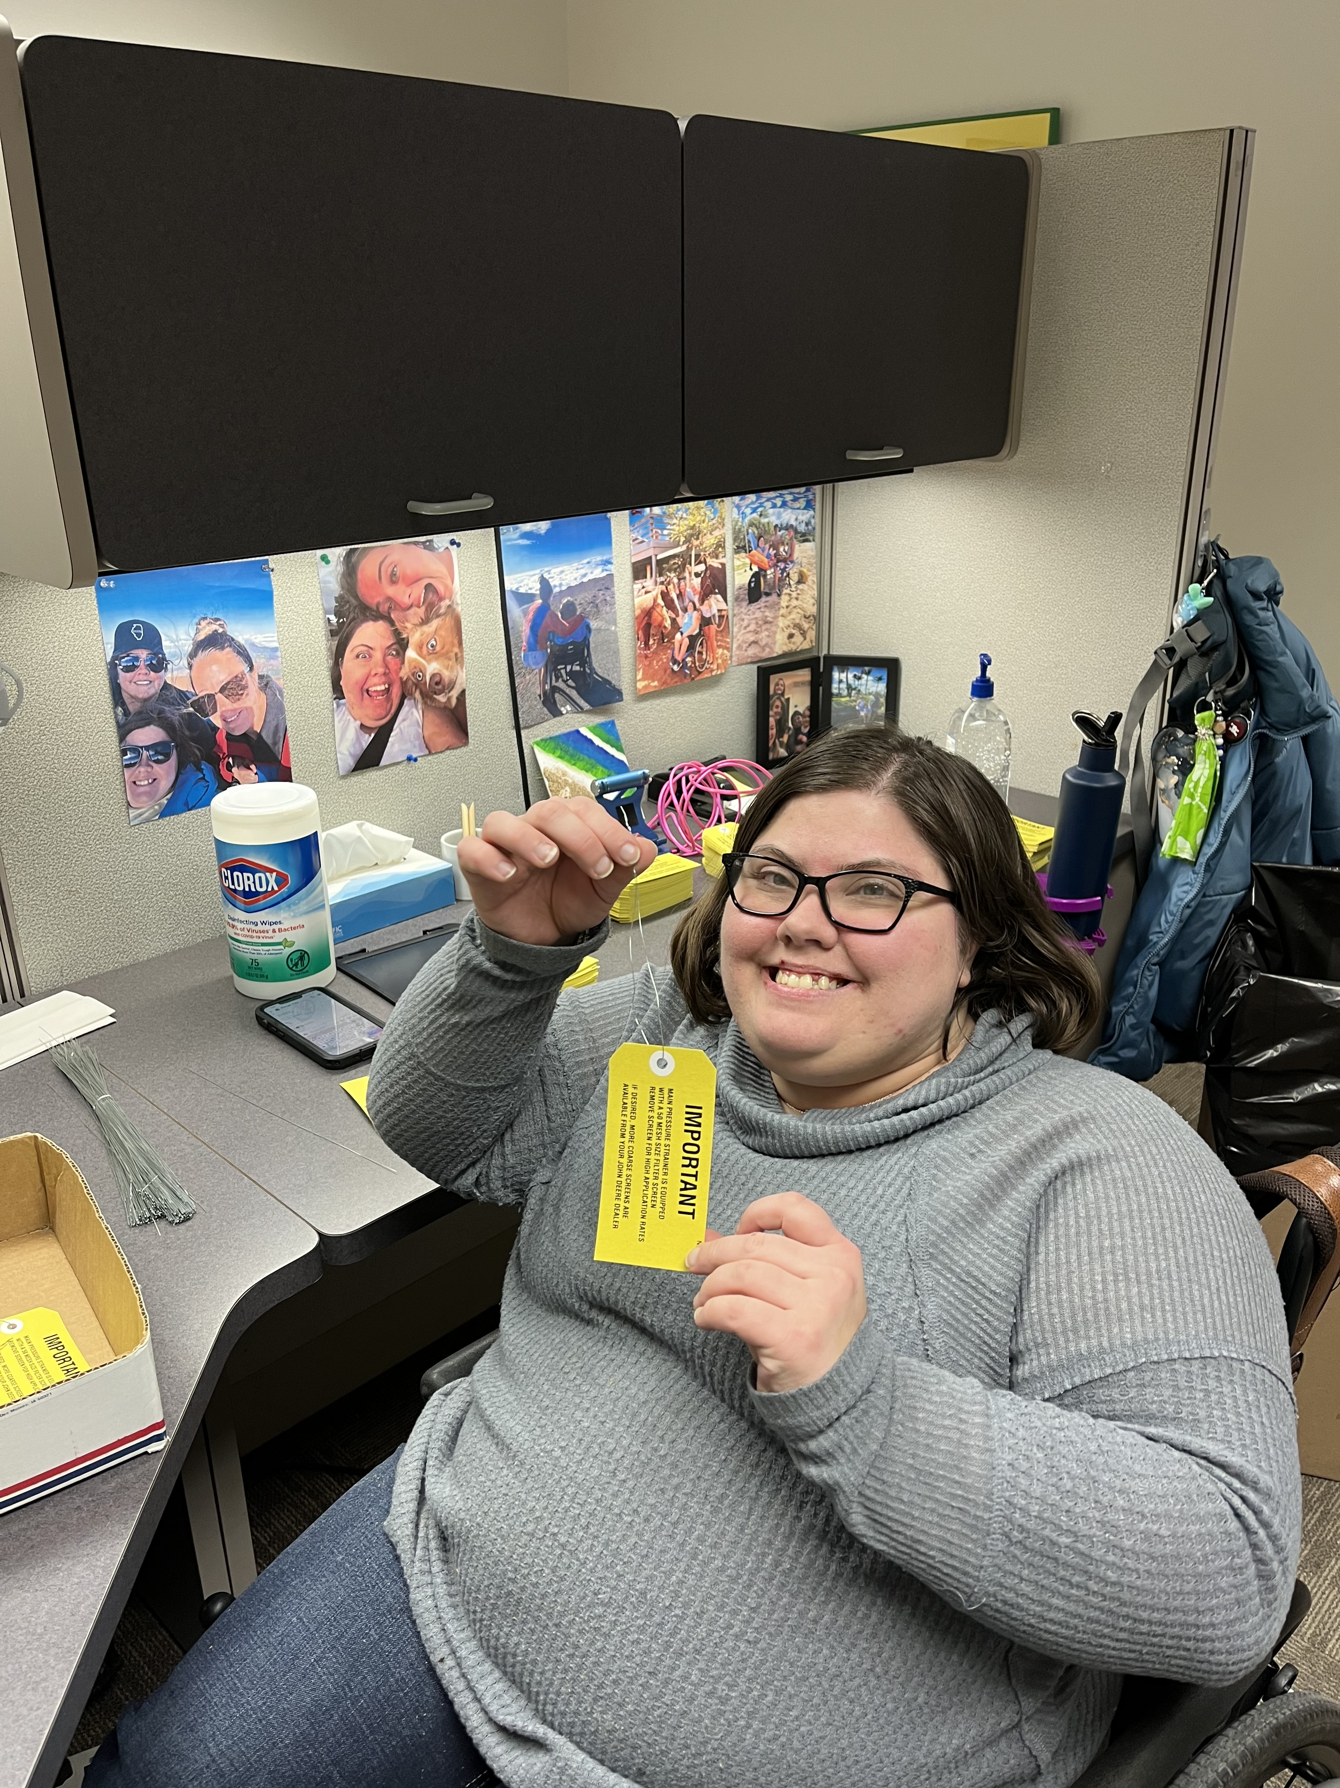
Customer Case Study: Meet Charly
Subminimum Wage Earner since 2016
Adult
Signcraft Screenprint, Inc.
$15.00/hr
20 Hours/week

Slide 6
Charly’s Team
DRS counselor: Louise Hrubecky (Sterling Office)
UIUC community research specialist: Sharon Bergfeld
Agency employment specialist: Kathy Thimmesch
Personal support worker: none
Wrap around or other special services: none
Key family supporters: Mom, Dad, and Adult Sister
On the job supporters: Tammy Glasgow (supervisor); Judy, Tiffany, Courtney (teammates)

Slide 7
Charly’s DRS process
What Contract type: SEP
Date of Referral: 12/8/23
Date of Eligibility: 1/3/24
Date of IPE initiation: 1/3/24
What information was sent with the referral:
Charly attends The Workshop and previously had a case open with DRS that was closed before Charly was placed
What additional information was required to determine eligibility:
Information from The Workshop file, DRS file, family, and health professionals.

Slide 8
Charly’s Employer
Employer: Signcraft Screenprint, Inc.
Job title: Final Inspector
Charly’s supervisor and teammates provide accommodations for this regular company position
What makes this a good job fit?
Charly’s mother previously worked at Signcraft.
Charly and Mom both agreed this would be a great match.
Charly and her family have a cousin and friends who work at Signcraft.

Slide 9
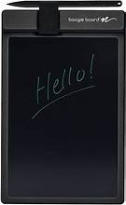
Charly’s Employment Barriers
Employment Barrier | Mitigation Strategies
Communication barriers – Charly has hearing loss. | Charly taught her team how to use the “Hand Talk” app for translating and learning ASL Sign Language. Charly showed her team “ChatBoard” which can be used as a voice to text or typing app. Reusable writing board that she keeps on her desk for Charly and her coworkers to write notes. Charly and her team created a list of signs that Charly typically uses in the workplace. They’re in a binder and posted on the wall in Charly’s office.
Physical barriers – Charly uses a wheelchair. | A plan involving Transit drivers and Signcraft staff was created to assist Charly entering/exiting the building. Charly carries her phone and texts her team if she needs assistance. Charly’s desk/cubicle is arranged so she’s comfortable and has access to what she needs. Charly’s family purchased a tray that attaches to her wheelchair to carry items when she moves throughout the building.
Transportation | Charly utilizes public transportation which has limited hours. Charly’s mom drives her to and from work when Transit is closed.

Slide 10
Lessons Learned
What did you learn with this customer’s employment process? I learned …
communication is key
power of working as a team
the positive impact of inclusivity in the workplace
What will you do differently with the next customer?
Help set up direct communication between the customer and coworkers before the first day
Find time to meet with coworkers prior to start date
What are your strategies to ensure the customer and employer remain satisfied for this employment situation?
Informal check-ins with customer and employer at least once a week
Progress report based on employer feedback and observations
Weekly communication with parents/guardians
Weekly observations on the job site, including conversation with coworkers

Slide 11
Message from Charly
What do you like best about your job (and why)?
The people I work with are nice.
Having a job gives me something to do.
How does working at Signcraft and being a SWTCIE participant make you feel?
It makes me feel good – I’m happier.
What do you plan to/did you do with your first paycheck?
I plan to go to Hobby Lobby and get beads to make jewelry.

Slide 12
SWTCIE Illinois
What are the questions from the SWTCIE Illinois COP community?

Slide 13
Open Discussion
Questions
Concerns
Advise/Support
General Comments

Slide 14
End

